Slide 1
Thinking and Intelligence

Slide 2
Thinking
Thinking is brain activity in which we mentally manipulate information, including words, visual images, sounds, or other data.
Thinking transforms information into new and different forms, allowing us to answer questions, make decisions, solve problems, or make plans.

Slide 3
We make mental images
Mental images are representations in the mind of an object or event.
They are not just visual; our ability to “hear” a tune in our heads also
relies on a mental image.

Slide 4
We create “concepts” & “prototypes”
Concepts are mental groupings of similar objects, events, or people.
For example, an equilateral triangle is a closed shape that has three sides of equal length. If an object has these characteristics, it is an equilateral triangle; if it does not, it is not an equilateral triangle.
Sometimes we create prototypes which fit a broad range of object or things
For instance, broader concepts such as “table” and “bird” contain many similar objects/animals

Slide 5
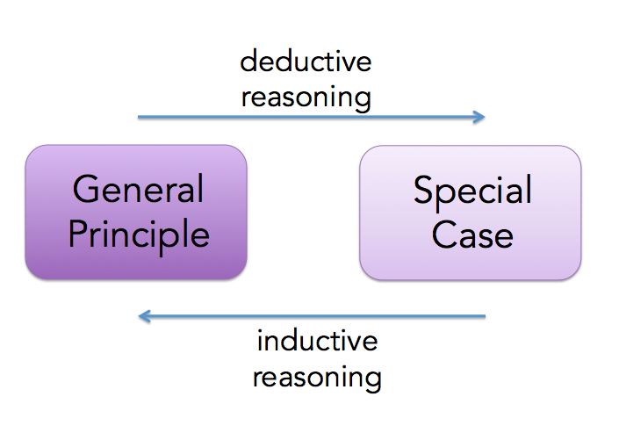
Reasoning
Reasoning is the process by which information is used to draw conclusions and make decisions.

Slide 6
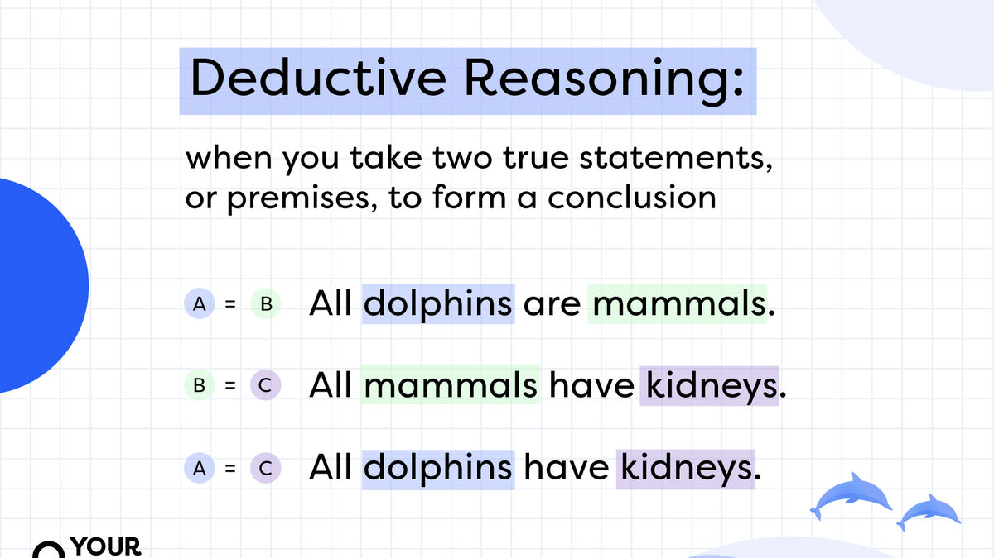

Slide 7
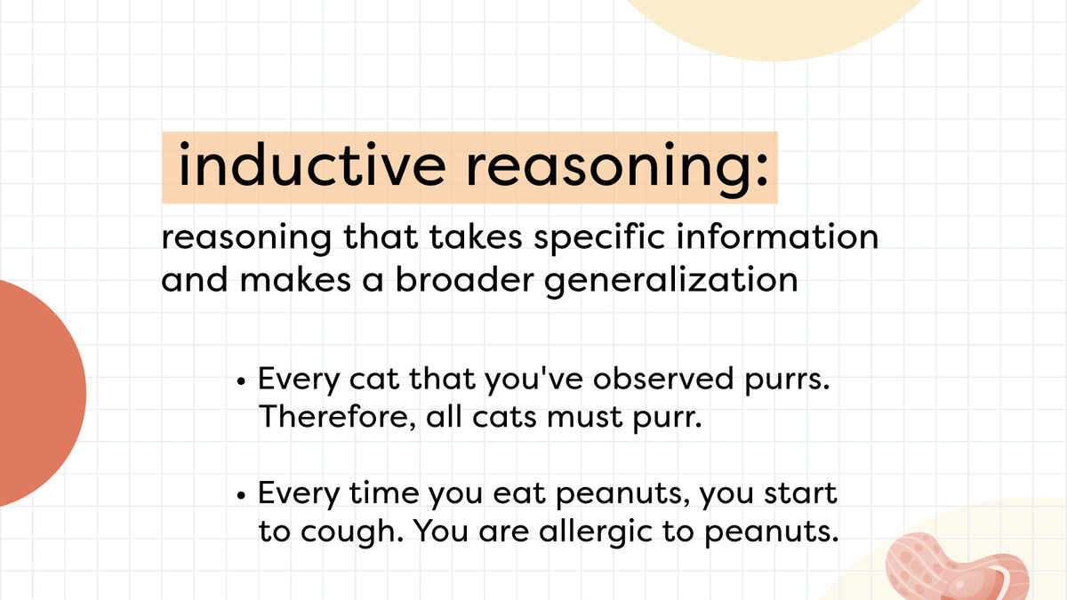

Slide 8
Heuristic
A heuristic is a thinking strategy that may lead us to a solution to a problem or decision, but—unlike algorithms— may sometimes lead to errors.
Mental shortcuts- easier to process
Familiarity heuristic, in which familiar items are seen as superior to those that are unfamiliar.
The availability heuristic involves judging the likelihood of an event occurring on the basis of how easy it is to think of examples.
For instance, the availability heuristic makes us more afraid of dying in a plane crash than in an auto accident, despite statistics clearly showing that airplane travel is much safer than auto travel.

Slide 9
Problem Solving
1. Understanding and Diagnosing Problem
Problem identification
Ill defined problem: where information required to solve the problem is less clear & less obvious E.g: jigsaw puzzle
Well defined problem: where information required to solve the problem is well defines and obvious E.g: bring peace to the world

Slide 10
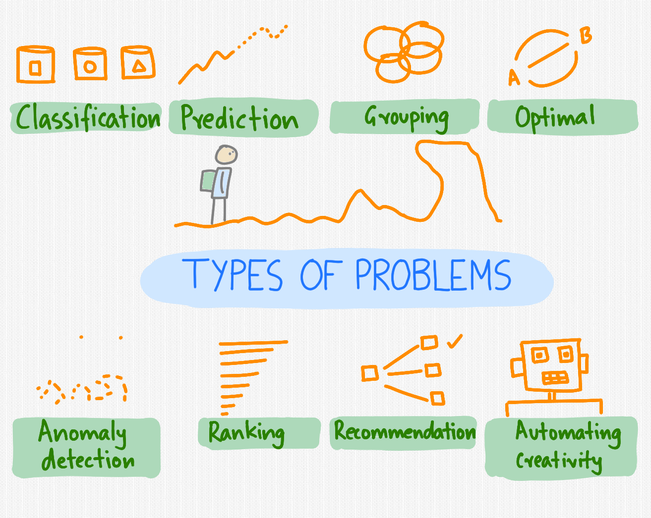
Cont.
Kinds of Problems

Slide 11
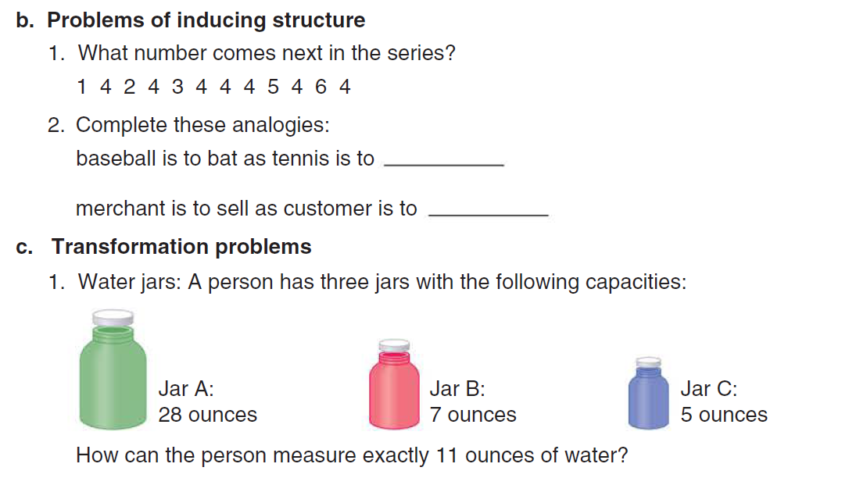
Cont.
2. Problem organization
Organize the information presented

Slide 12
Generating Solution
At the most basic level, we can solve problems through trial and error.
In place of trial and error, complex problem solving often involves the use of heuristics
Means-ends analysis involves repeated tests for differences between the desired outcome and what currently exists.
1. Forming Sub-goals : Dividing Problems Into Their Parts
2. Insight & Awareness
Think from large to small
The end goal is split into a few smaller goals- that can be achieved

Slide 13
Intelligence

Slide 14
Intelligence
Intelligence is the capacity to understand the world, think rationally, and use resources effectively when faced with challenges.

Slide 15
Fluid vs Crystalline Intelligence
Fluid intelligence is the ability to reason
abstractly.
It reflects our ability to call up information from long-term memory.
It reflects our ability to reason effectively, identify patterns, and recognize relationships between concepts.
If we were asked to solve an analogy or group a series of letters according to some principle, we would be using fluid intelligence
In contrast, crystallized intelligence is the accumulation of information, knowledge, and skills that people have learned through experience and education.
For instance, if we were asked to participate in a discussion about the solution to the causes of poverty, a task that allows us to draw on our own past experiences, education, and knowledge of the world.

Slide 16
Gardner's Theory of Multiple Intelligence
Gardner argues that we have a minimum eight different forms of intelligence, each relatively independent of the others:
musical,
bodily kinesthetic,
logical-mathematical,
linguistic,
spatial,
interpersonal,
intrapersonal, and
naturalist.

Slide 17
Emotional Intelligence
It is the set of skills that underlie the accurate assessment, evaluation, expression, and regulation of emotions.
Emotional intelligence is the basis of empathy for others, self-awareness, and social skills.
It encompasses the ability to get along well with others.
It provides us with an understanding of what other people are feeling and experiencing, which permits us to respond appropriately to others’ needs

